Slide 1
Why integration testing?

Slide 2
What will you learn?
Understanding the role of integration testing
Diving deeper into the Test Pyramid concept
Writing valuable integration tests

Slide 3
What is an integration test?

Slide 4
What is an integration test?
A test that is not a unit test
Unit test is a test that meets the following three requirements:
Verifies a single unit of behavior,
Does it quickly,
And does it in isolation from other test
Notes:
Ito start ng integrations test and 2 sessions.
A test that doesn’t meet at least one of these three requirements falls into the category of integration tests. An integration test then is any test that is not a unit test.
integration tests verify how your system integrates with out-of- process dependencies

Slide 5
The Test Pyramid revisited

Slide 6
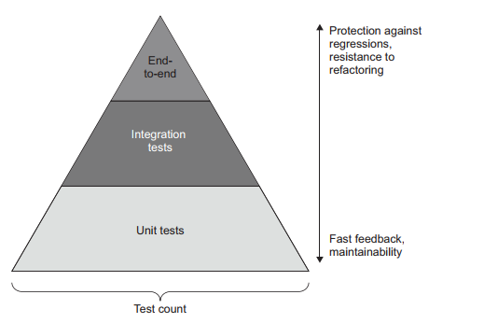
General rule of thumb is the following:
Unit test: check as many of the business scenarios.
Integration: cover one happy path.
Notes:
General rule of thumb is the following:
Check as many of the business scenario’s edge cases as possible with unit tests.
Use integration tests to cover one happy path, as well as any edge cases that can’t be covered by unit tests.

Slide 7
Integration testing vs. failing fast
Notes:
d.Integration testing vs. failing fastThis section elaborates on the guideline of using integration tests to cover one happy path per business scenario and any edge cases that can’t be covered by unit tests.
Making bugs manifest themselves quickly is called the Fail Fast principle,

Slide 8
// UserController
public string ChangeEmail(int userId, string newEmail)
{
User user = _repository.GetUserById(userId);
bool canChangeEmail = user.CanChangeEmail();
if (canChangeEmail == false)
return "Cannot change the email";
/* the rest of the method */
}
// User
public void ChangeEmail(string newEmail, Company company)
{
Precondition.Requires(CanChangeEmail() == null);
/* the rest of the method */
}
Notes:
//Controller
The controller invokes CanChangeEmail() and interrupts the operation if that method returns an error: This example shows the edge case you could theoretically cover with an integration test. Such a test doesn’t provide a significant enough value, though If the controller tries to change the email without consulting with CanChangeEmail() first, the application crashes. This bug reveals itself with the first execution and thus is easy to notice and fix. It also doesn’t lead to data corruption.
Making bugs manifest themselves quickly is called the Fail Fast principle, and it’s a viable alternative to integration testing.
//USER
the presence of the precondition in User should be tested. But that is better done with a unit test; there’s no need for an integration test.
There’s no need to test an edge case if an incorrect execution of that edge case immediately fails the entire application.

Slide 9
Which out-of-process dependencies to test directly
There are two ways to implement such verification:
Use the real out-of-process dependency.
Replace that dependency with a mock.
Notes:
As I mentioned earlier integration tests verify how your system integrates with out-of- process dependencies
Which are?

Slide 10
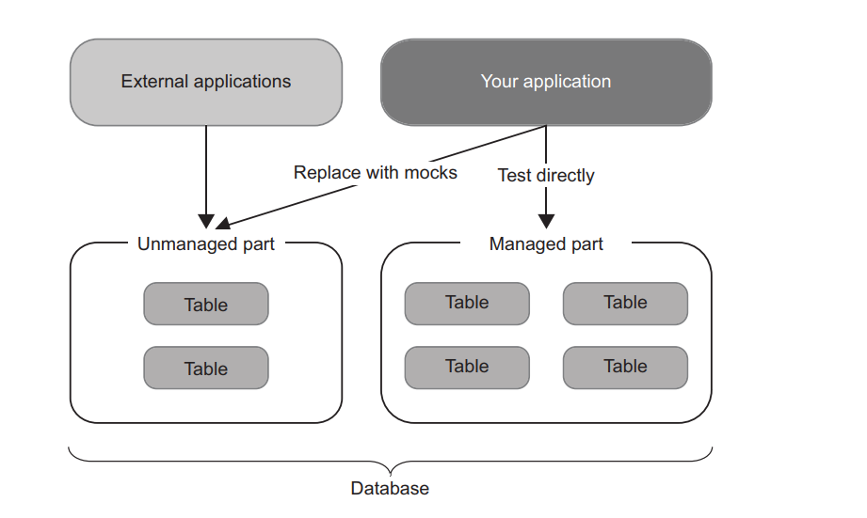
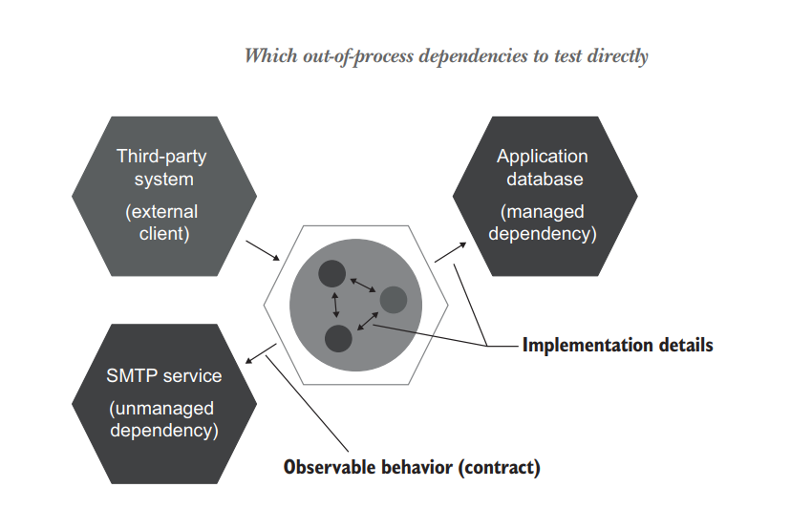
Which out-of-process dependencies to test directly
The two types of out-of-process dependencies
Managed dependencies (out-of-process dependencies you have full control over)
Unmanaged dependencies (out-of-process dependencies you don’t have full control over)
Notes:
integration tests verify how your system integrates with out-of-process dependencies. There are two ways to implement such verification:
Use the real out-of-process dependency
Replace that dependency with a mock.
Managed dependencies (out-of-process dependencies you have full control over)—These dependencies are only accessible through your application; interactions with them aren’t visible to the external world. A typical example is a database. External systems normally don’t access your database directly; they do that through the API your application provides.
Unmanaged dependencies (out-of-process dependencies you don’t have full control over)— Interactions with such dependencies are observable externally. Examples include an SMTP server and a message bus: both produce side effects visible to other applications

Slide 11
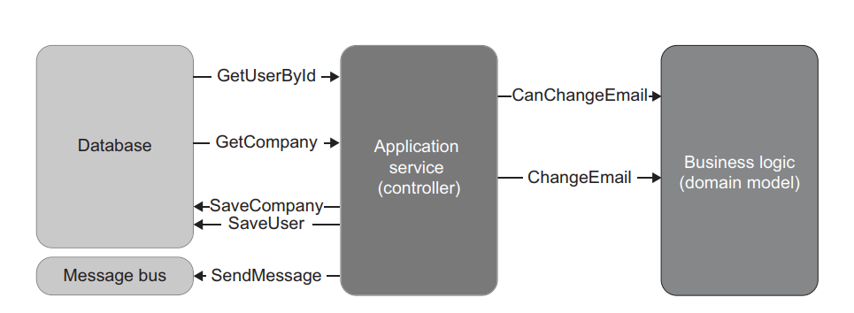
Integration testing: An example
CRM Project
Notes:
As you may recall, this system implements one feature: changing the user’s email. It retrieves the user and the company from the database, delegates the decision-making to the domain model, and then saves the results backl to the database and puts a message on the bus if needed

Slide 12
What scenarios to test?
The general guideline: Cover the longest happy path and any edge cases that can’t be exercised by unit tests.
The longest happy path is the one that goes through all out-of-process dependencies.

Slide 13
Side Effects and Categorizing the database and the message bus
In the database, both the user and the company are updated: the user changes its type (from corporate to non-corporate) and email, and the company changes its number of employees.
A message is sent to the message bus.
Notes:
In the CRM project, the longest happy path is a change from a corporate to a noncorporate email. Such a change leads to the maximum number of side effects:
Before writing the integration test, you need to categorize the two out-of-process dependencies and decide which of them to test directly and which to replace with a mock. The application database is a managed dependency because no other system can access it. Therefore, you should use a real instance of it. The integration test will ○ Insert a user and a company into the database. ○ Run the change of email scenario on that database. ○ Verify the database state. On the other hand, the message bus is an unmanaged dependency—its sole purpose is to enable communication with other systems. The integration test will mock out the message bus and verify the interactions between the controller and the mock afterward.

Slide 14
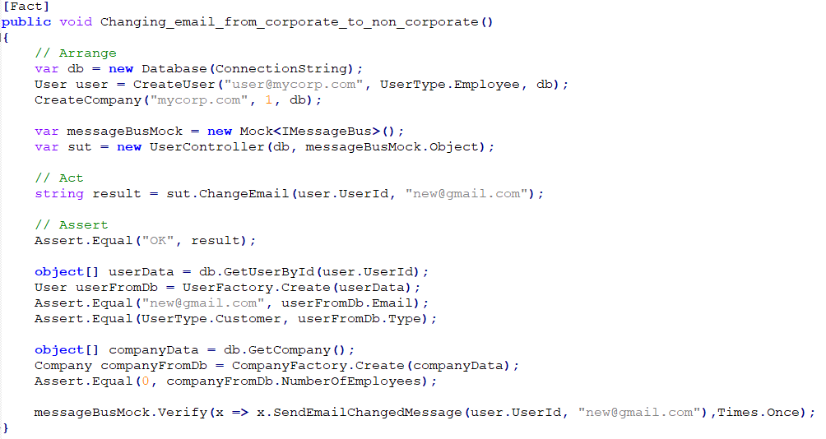
Integration testing: The first try
Database repository
Creates the user and company in the database
Sets up a mock for the message bus
Asserts the company’s state
Asserts the company’s state
Checks the
Interactions with the mock
Notes:
Box code instead of label
Animation

Slide 15
10 Mins break

Slide 16
Using interfaces to abstract dependencies

Slide 17
Interfaces and loose coupling
Interfaces with a single implementation are not abstractions and don’t provide loose coupling any more than concrete classes that implement those interface.
Genuine abstractions are discovered, not invented.

Slide 18
Interfaces and loose coupling
The common reasoning behind the use of such interfaces is that they help to
Abstract out-of-process dependencies, thus achieving loose coupling
Add new functionality without changing the existing code, thus adhering to the Open-Closed principle (OCP)
The second reason (the ability to add new functionality without changing the existing code)
Violates: YAGNI stands for “You aren’t gonna need it”
Notes:
Many developers introduce interfaces for out-of-process dependencies, such as the database or the message bus, even when these interfaces have only one implementation. The second reason (the ability to add new functionality without changing the existing code) is a misconception because it violates a more foundational principle: YAGNI. YAGNI stands for “You aren’t gonna need it” and advocates against investing time in functionality that’s not needed right now.

Slide 19
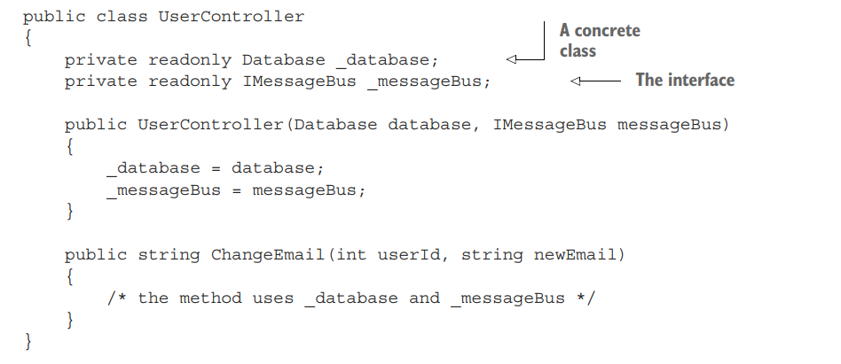
Why use interfaces for out-of-process dependencies?
It’s to enable mocking—as simple as that
Notes:
Without an interface, you can’t create a test double and thus can’t verify interactions between the system under test and the out-of-process dependency
You only mock out unmanaged dependencies, so the guideline can be boiled down to this: use interfaces for unmanaged dependencies only.
Still inject managed dependencies into the controller explicitly, but use concrete classes for that.
why use interfaces for out-of-process dependencies at all, assuming that each of those interfaces has only one implementation?
And you might have noticed in listing 8.2 that UserController now accepts both the message bus and the database explicitly via the constructor, but only the message bus has a corresponding interface. The database is a managed dependency and thus doesn’t require such an interface. Here’s the controller:

Slide 20
Integration testing best practices
Making domain model boundaries explicit
Reducing the number of layers in the application
Eliminating circular dependencies

Slide 21
How to test logging functionality

Slide 22
Should you test logging?

Slide 23
Types of logging
Support logging
Diagnostic logging
Notes:
Support logging produces messages that are intended to be tracked by support staff or system administrators.
Diagnostic logging helps developers understand what’s going on inside the application

Slide 24
How should you test logging? --- XXX
Logging involves out-of-process dependencies
Need to use mocks to verify interactions between your application and the log storage.
Notes:
XXX NEED TO RE-READ

Slide 25
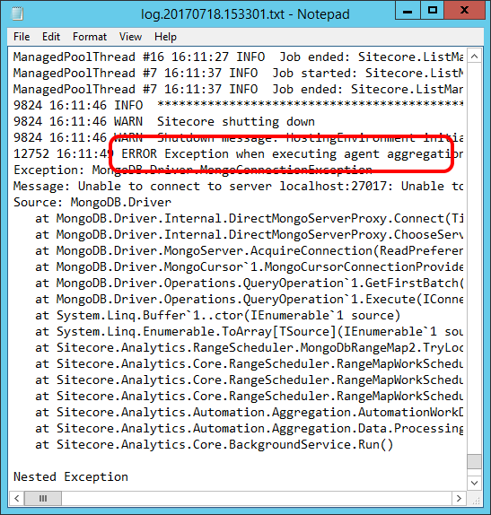
How much logging is enough?
It’s important not to overuse diagnostic logging, for the following two reasons:
Excessive logging clutters the code.
Logs’ signal-to-noise ratio is key.
Notes:
Support logging is out of the question here because it’s a business requirement. You do have control over diagnostic logging, though.
Excessive logging clutters the code. This is especially true for the domain model. That’s why I don’t recommend using diagnostic logging in User even though such a use is fine from a unit testing perspective: it obscures the code.
○ Logs’ signal-to-noise ratio is key. The more you log, the harder it is to find relevant information. Maximize the signal; minimize the noise.

Slide 26
Take a way
Treat support logging like any other functionality.
Don’t test diagnostic logging.
Should only use diagnostic logging for unhandled exceptions.
Notes:
Treat support logging like any other functionality that works with an out-of-process dependency.
Don’t test diagnostic logging. Unlike support logging, you can do diagnostic logging directly in the domain model.
Use diagnostic logging sporadically. Excessive diagnostic logging clutters the code and damages the logs’ signal-to-noise ratio. Ideally, you should only use diagnostic logging for unhandled exceptions.

Slide 27
So Why Integration test?
Overall, integration testing is to ensure the quality and reliability of a software system
There are several reasons why integration testing is important:
To ensure that the different components of the system work together seamlessly
To verify that the system meets the requirements
To detect defects early
To reduce the risk of system failure
Notes:
Integration testing helps to ensure that the different modules or components of a system work together as expected and do not cause any conflicts or errors when they are integrated. To verify that the system meets the requirements: Integration testing helps to verify that the system meets the specified requirements by testing the integration between the different components.
To detect defects early: Integration testing helps to detect defects or errors early in the software development life cycle, which can save time and money by preventing these defects from being propagated to later stages of development.
To reduce the risk of system failure: Integration testing helps to reduce the risk of system failure by detecting and resolving issues that may arise due to the interactions between different components of the system.

Slide 28
Summary
An integration test is any test that is not a unit test. Integration tests verify how your system works in integration with out-of-process dependencies: – Integration tests cover controllers; unit tests cover algorithms and the domain model
The Fail Fast principle advocates for making bugs manifest themselves quickly and is a viable alternative to integration testing.
Managed dependencies are out-of-process dependencies that are only accessible through your application. Interactions with managed dependencies aren’t observable externally. A typical example is the application database.
Unmanaged dependencies are out-of-process dependencies that other applications have access to. Interactions with unmanaged dependencies are observable externally. Typical examples include an SMTP server and a message bus
Don’t test diagnostic logging

Slide 29
Thank you!

